Slide 1

Watson Assistant Labs
21.11.2019

Slide 2
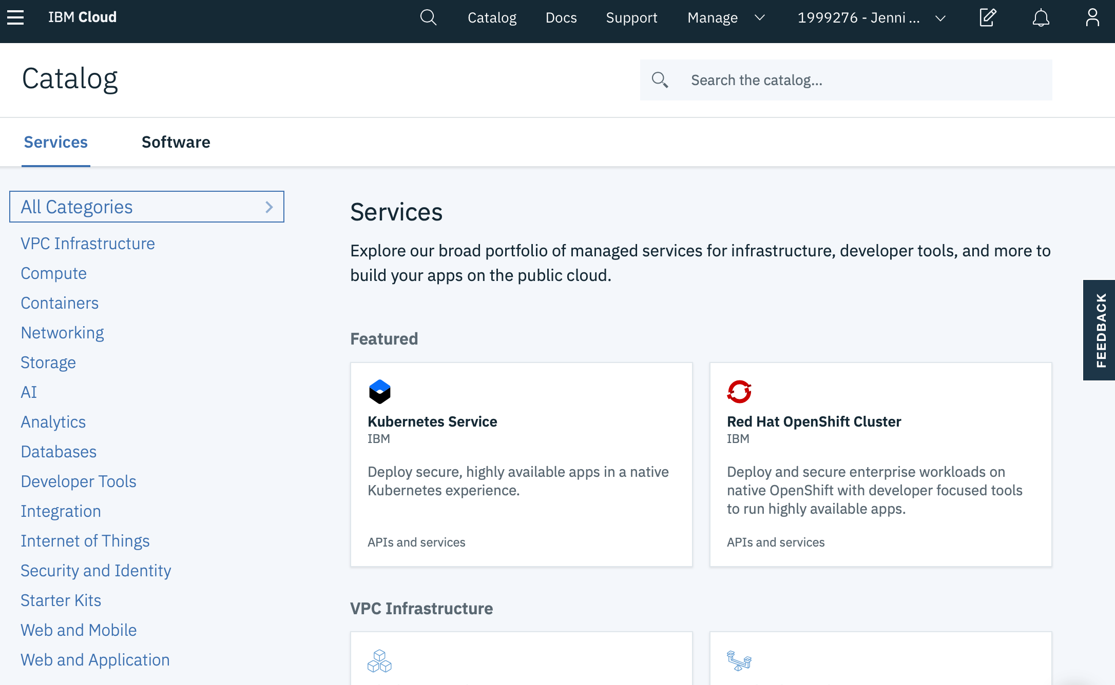
IBM Cloud

Slide 3
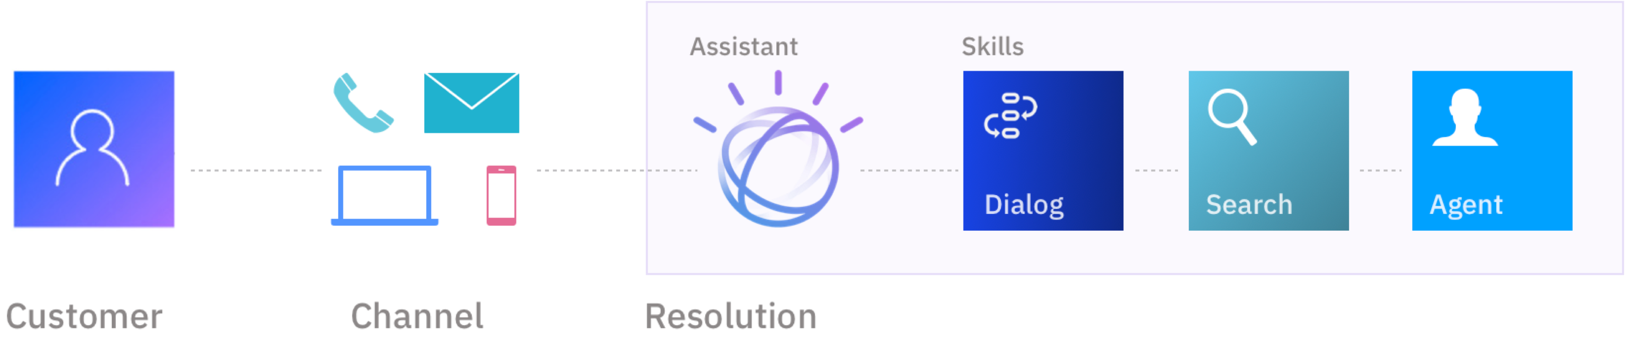
Watson Assistant
Watson Assistant understands the user's intent by utilising the latest Deep learning techniques. Learns over time based on usage.
Notes:
Used to create conversation flows between your apps and your users
machine learning
natural language understanding
integrated dialog tools

Slide 4
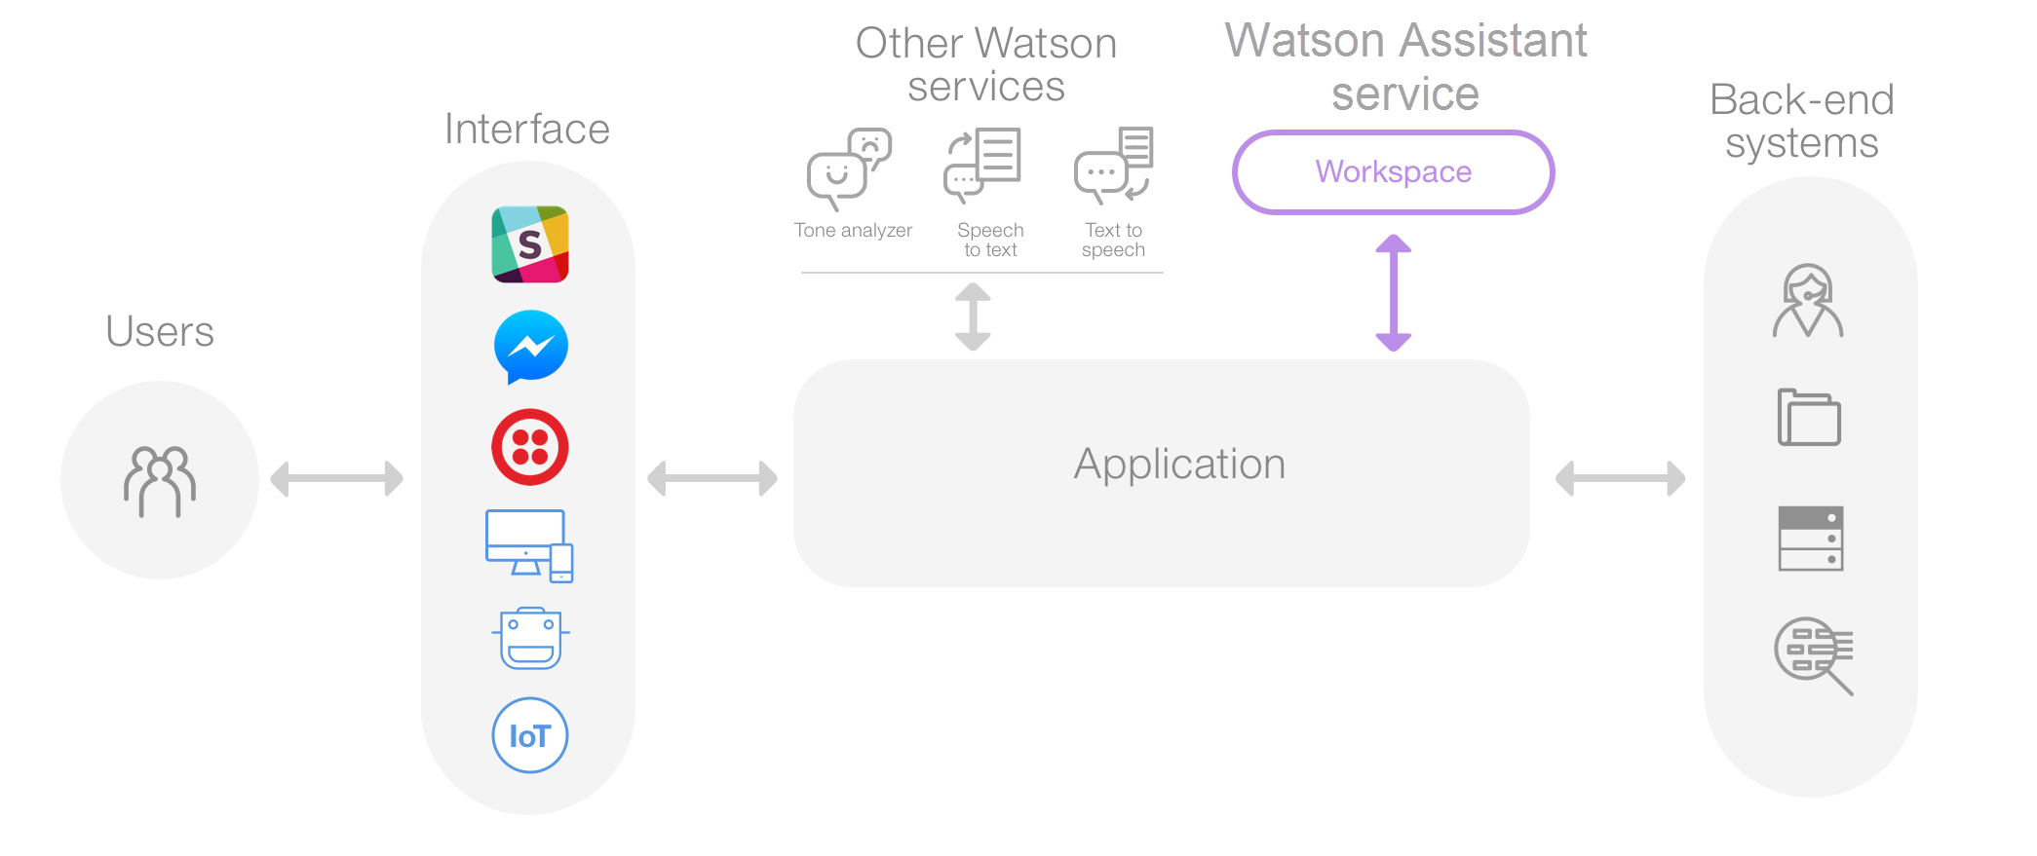
Cognitive Chatbot – Architecture
Wikipedia
Watson Discovery
Watson NLU
Notes:
- This is a common Watson Assistant architecture
- Application can use multiple UIs
- FLOW of the conversation is controlled by Watson Assistant
- INTERFACES to back-end systems when required
- We'll utilise this architecture, using:
- A web application & Slack as our UIs, and
- Discovery, NLU & IBM CFs to enhance our bot

Slide 5
Focus on repeated intents to handle the bulk of questions
Basic Concepts
Repeated intents in the fat head can be reasonably modeled and handeled for the selected focus area.
Modelling of infrequent intents in the long tail is difficult and unreasonable. We use Discovery for this!
80 %
OF QUESTIONS
20 %
OF INTENTS

Slide 6


Chatbot: Question Distribution
Watson
Assistant
Here Watson uses reasoning strategies that focus on the language and context of the question.
How do I get a Visa?
I need to visit Zimbabwe as a British citizen with a criminal record—can I do that?
Frequency of Questions
Watson Discovery
Here Watson uses reasoning strategies that focus on identifying the most appropriate answer.
Short Tail
Long Tail
100s
100,000+
Unique Intents
Notes:
- We will use Watson Assistant and Watson Discovery to
answer both short-tail and long-tail questions
- Short-tail questions are typically more PREDICTABLE and
FREQUENT, and will be dealt with by Assistant
- Long-tail questions are typically more SPECIFC, and
retrieved from a KNOWLEDGE BASE, which we will do here
with Discovery

Slide 7




Key Use Cases
Customer Care
Through the Watson Assistant, IBM can decrease call center operations cost, while improving the customer experience and developing new revenue streams.
Conversational Commerce
Provide guided buying experience for prospective customers to purchase goods and services through the mobile or messaging channel of their choice.
Employee Productivity
Simplify access to common questions and tasks through enterprise channels – often HR related.
7
7
7
20 November 2019
© 2018 IBM Corporation
© 2017 IBM Corporation
© 2017 IBM Corporation

Slide 8
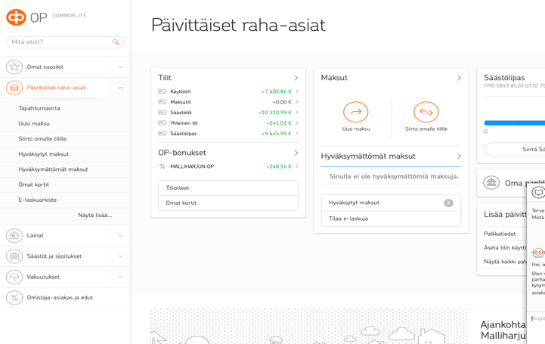


Case study at IBM.com
Opotti Chatbot
OP Financial Group is enhancing customer experience at scale with an AI-powered chatbot.
Improved customer service
Opotti responds to user interactions in seconds and frees up customer agents’ time for more complex cases requiring emotional intelligence.
Increased operational efficiency
Opotti can help countless number of customers simultaneously, therefore minimizing queues and enabling OP to scale their chat channel without having to increase the size of their customer service team.
To meet the growing demand of strategically important chat channel, OP and IBM developed a virtual agent for banking to handle incoming customer inquiries. Opotti enables customers to interact with natural language in Finnish, and get their issues resolved in no time.
Opotti has learned up to 1,000 answers in multiple areas e.g. accounts, payments, loans, investments, and online services. The basis for Opotti’s Agile development was a customer oriented approach which emphasized seamless cooperation between Opotti and his human colleagues.

Slide 9
Lab 1: Cognitive Chatbot Basics
Create a basic chatbot to help guide you when buying a new mobile phone
Watson Assistant

Slide 10

Agenda
Setup a Watson Assistant instance
Create a skill
Create intents, entities
Create a dialog tree utilising both intents and entities
Test your chatbot
Adding rich content: sending images

Slide 11
Intents and Entities
Intents are a purpose or goal expressed by a user’s input
recognise user’s intent => choose the correct dialog flow / response
provide Watson Assistant with multiple examples (train)
Entities represent a class of object or a data type
can be used to trigger different responses, even for same intent
In our labs:
intents
newphone (‘I want to get a new phone’, ‘I’d like advice on a new mobile’,…)
positive (‘I like my Galaxy’, ‘I love my phone’, …)
negative (‘I don’t like my iPhone’, ‘I hate my mobile’, …)
entities
brand (Apple, Samsung, HTC, …)
attribute (style, battery, …)

Slide 12
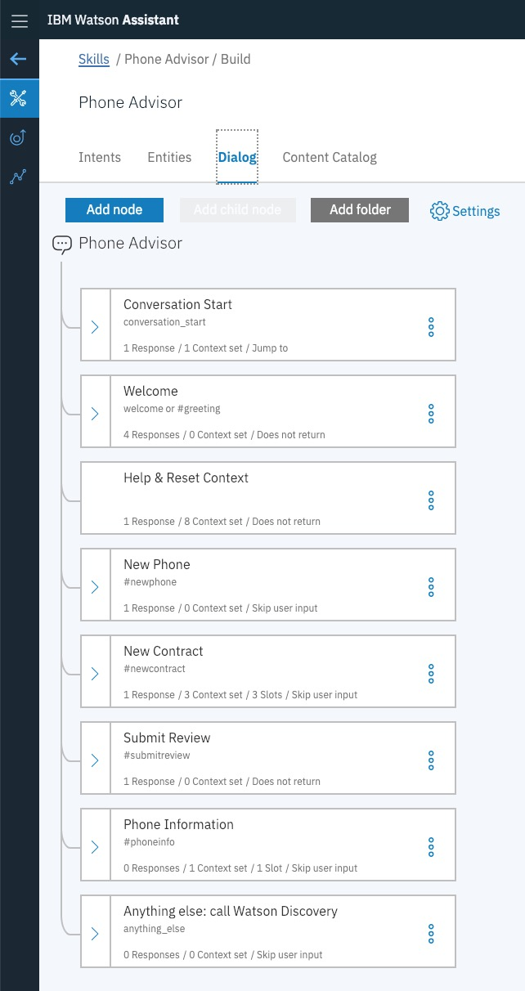
Dialog
Defines the flow of your conversation in the form of a logic tree
Each node of the tree has a condition that triggers it, based on user input
Uses intents and entities
Interacts with the user and provides a response
text, images, options

Slide 13
Lab 2: Chatbot Integrations
Use Watson Assistant integrations to access your chatbot using:
a web-hosted chat widget you can use for testing
a live, publicly available web-hosted version of your chatbot

Slide 14
Agenda
Create an Assistant for your skill
Create a Preview Link: a web widget to test your chatbot
Setup a live web-hosted chatbot

Slide 15
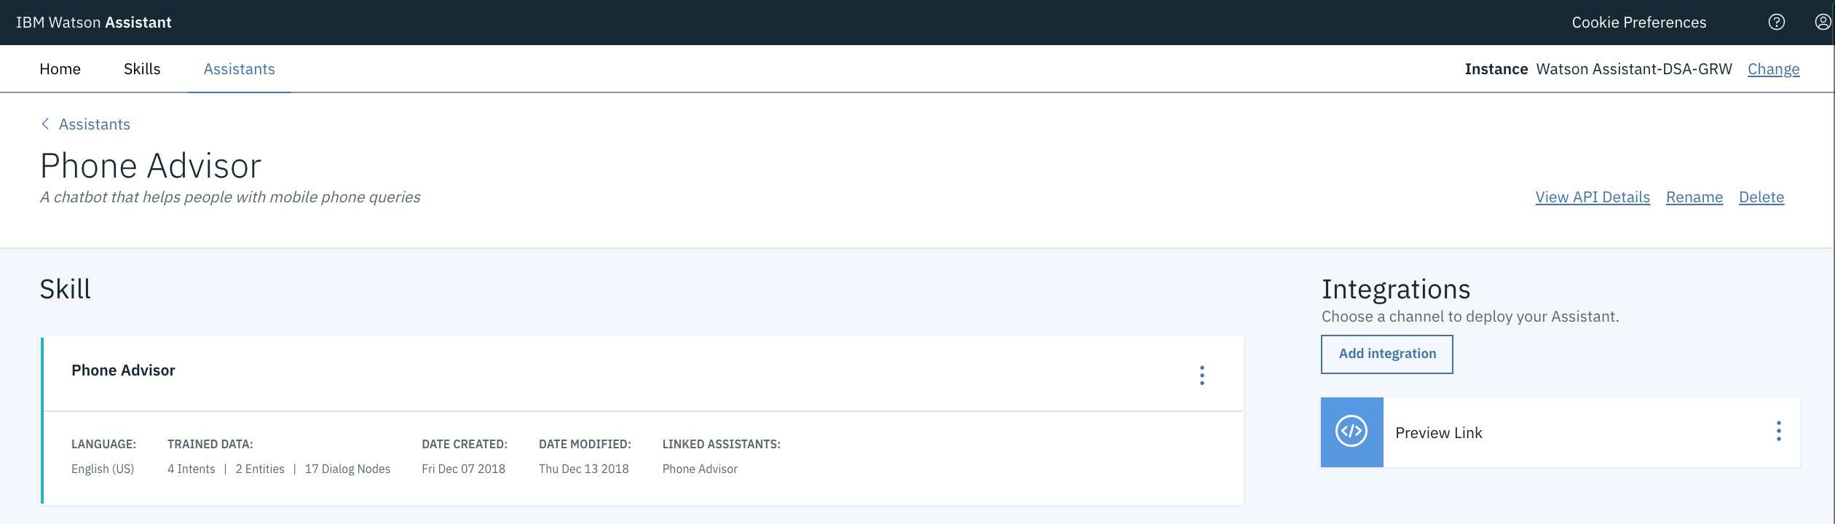
Integrations & Assistants
An assistant is the user-facing component that manages the flow of information between your skills and your end-users
Assistants allow you to create integrations that publish your chatbot to the channels where your users go for help
e.g. Slack, Facebook Messenger, Wordpress

Slide 16
Lab 3: Understanding User Sentiment - Integrating Watson Natural Language Understanding
Extend your chatbot to provide a new function
Allow the user to submit a review of a phone and respond based on user sentiment
Use Watson Assistant option response to prompt the user
Introduce Watson Natural Language Understanding (NLU)
Sentiment analysis
Emotion analysis
Extracting entities, keywords and concepts
Use IBM Cloud Functions to integrate Watson NLU into your chatbot

Slide 17
Agenda
Introduction to Watson NLU
Setup an IBM Watson NLU instance
Create Sentiment Analysis IBM Cloud Function
Setup Watson Assistant to use IBM Cloud Functions
Create Submit Review intent and dialog

Slide 18
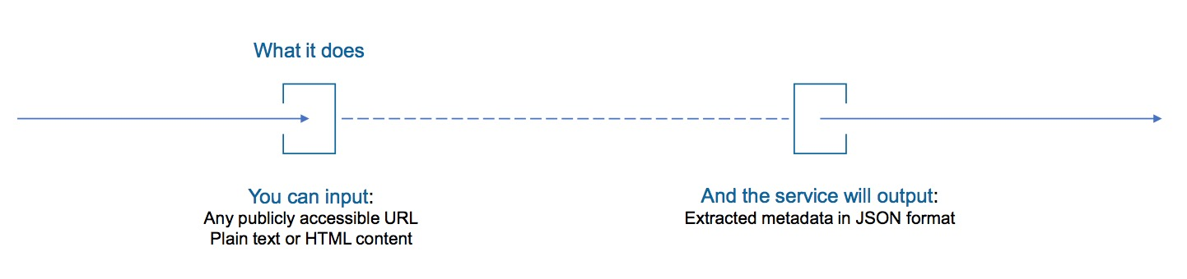
Watson Natural Language Understanding
Easy to use semantic text analysis service
Uncovers insights from structured and unstructured data
extracts metadata from content such as concepts, entities, keywords, categories, relations and semantic roles
Understand sentiment and emotion
Use cases
monitor sentiment and emotion in customer support chat transcripts
categorise blog posts - sort them based on general concepts, keywords, and entities
Full support for English, partial support for Arabic, Chinese, Dutch, French, German, Italian, Japanese, Korean, Portuguese, Russian, Spanish, Swedish

Slide 19
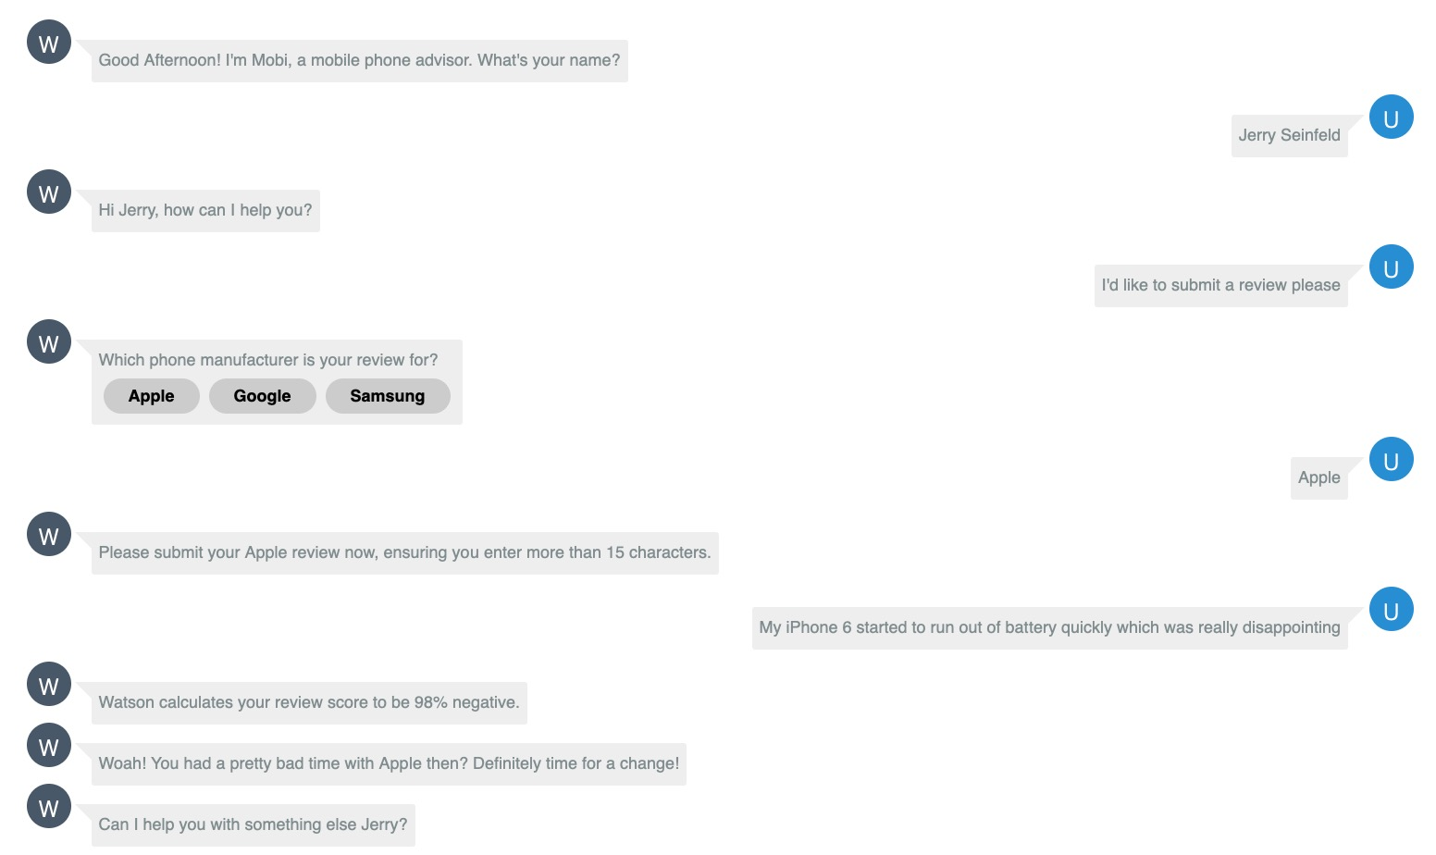
Watson Natural Language Understanding
Passed to NLU
Response based on sentiment

Slide 20
IBM Cloud Functions
With IBM Cloud Functions you can:
lightweight code that executes application logic in a scalable way
run this code on-demand via requests from applications or automatically in response to events
How we might use an IBM Cloud Function from within Watson Assistant?
Validate information you collect from a user
Perform calculations or string manipulations on user input that are too complex for expressions to handle
Interact with an external web service to get information, e.g. check on the expected arrival time for a flight from an air traffic service
Send requests to an external application, e.g. restaurant reservation site, to complete a simple transaction on the user's behalf

Slide 21
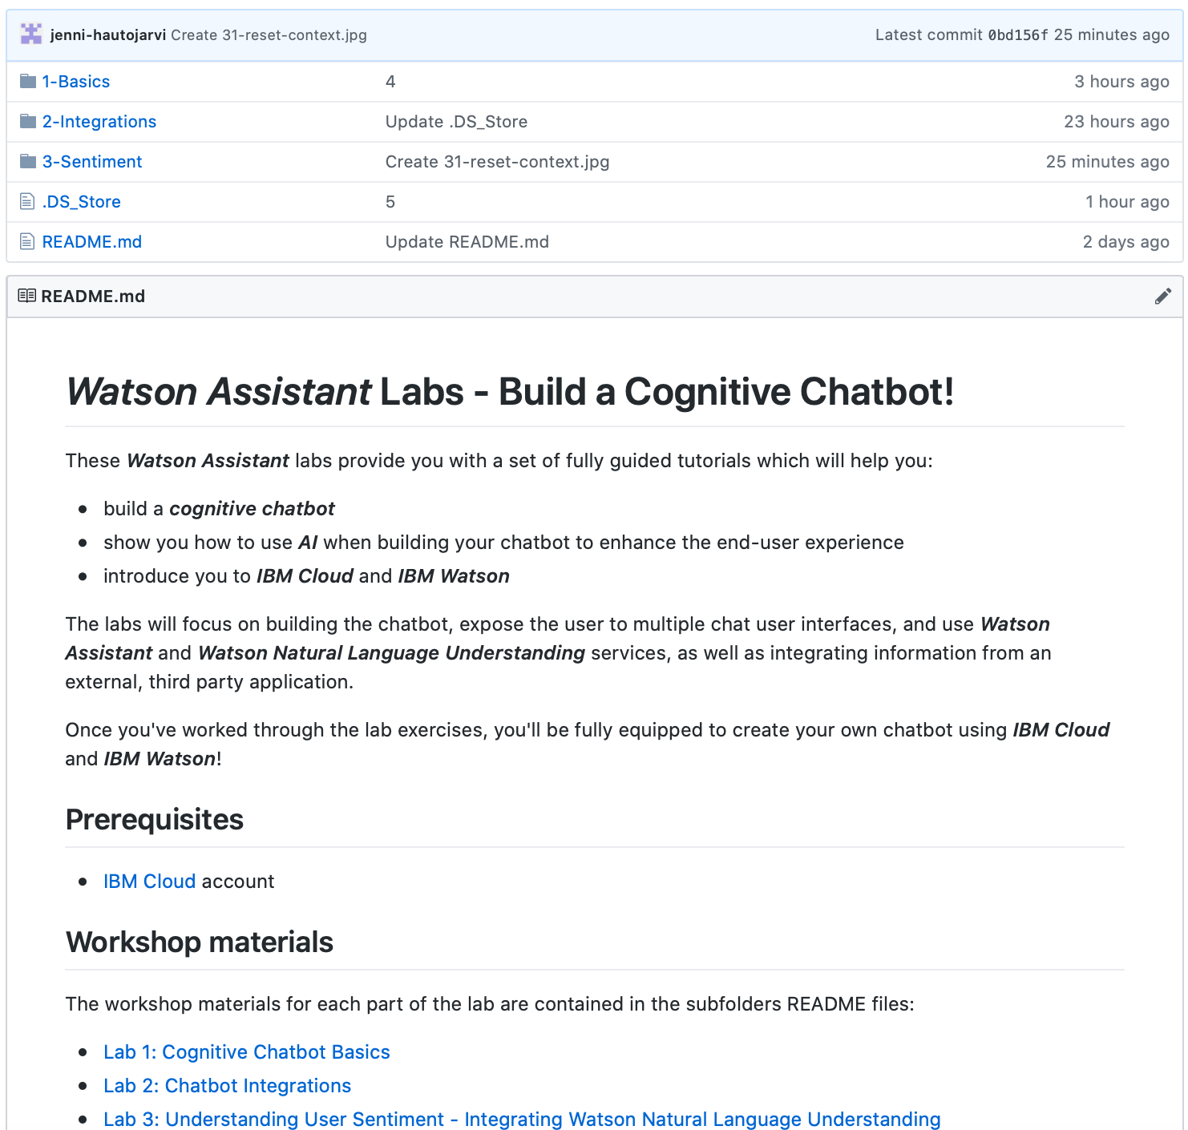
Lab Format
Step-by-step instructions
GitHub README.md for each lab
Work at your own pace
https://github.com/jenni-hautojarvi/Watson-Assistant-Labs

